Slide 1
MQTT TUTORIAL

Slide 2
MQTT
Message Queuing Telemetry Transport
MQTT was developed by Andy Stanford-Clark (IBM) and Arlen Nipper (Cirrus Link) in 1999 for the monitoring of an oil pipeline through the desert.
The goals were to have a protocol, which is bandwidth-efficient and uses little battery power
The protocol uses a publish/subscribe architecture in contrast to HTTP with its request/response paradigm.

Slide 3
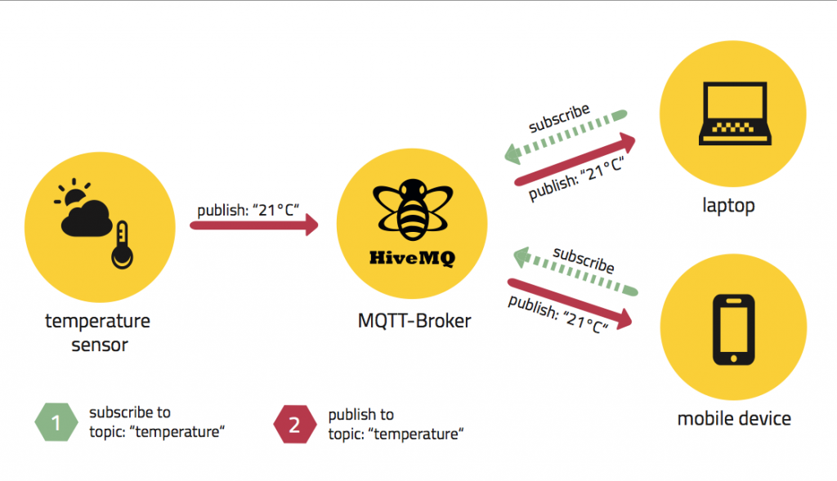
MQTT Publish-Subscribe Architecture

Slide 4
Basic Terms
Broker: The broker accepts messages from clients and then delivers them to any interested clients. Messages belong to a topic. (Sometimes brokers are called “servers.”)
Client: A “device” that either publishes a message to a topic, subscribes to a topic, or both.
Topic: A namespace (or place) for messages on the broker. Clients subscribe and publish to a topic.
Publish: A client sending a message to the broker, using a topic name.
Subscribe: A client tells the broker which topics interest it. Once subscribed, the broker sends messages published to that topic. (In some configurations the broker sends “missed” messages.) A client can subscribe to multiple topics.
Unsubscribe: Tell the broker you are bored with this topic. In other words, the broker will stop sending messages on this topic.

Slide 5
MQTT Broker
Each client that publishes a message to the broker, includes a topic into the message
The topic is the routing information for the broker
Each client that wants to receive messages subscribes to a certain topic and the broker delivers all messages with the matching topic to the client.
Therefore the clients don’t have to know each other, they only communicate over the topic.

Slide 6
MQTT Broker
Mosquitto (open source)
HiveMQ (commercial)

Slide 7
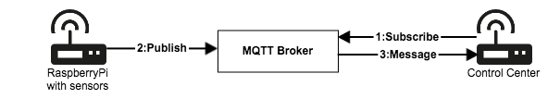
Use Case

Slide 8
MQTT Client
Paho python MQTT
MQTT.fx (http://www.jensd.de/apps/mqttfx/)
mqtt-spy (http://kamilfb.github.io/mqtt-spy/)
MyMQTT (https://play.google.com/store/apps/details?id=at.tripwire.mqtt.client)
MQTT Lens (https://chrome.google.com/webstore/detail/mqttlens/hemojaaeigabkbcookmlgmdigohjobjm)

Slide 9
Publish
To publish a messages you use the publish method of the Paho MQTT Class object.
The publish method accepts 4 parameters. The parameters are shown with their default values: publish(topic, payload=None, qos=0, retain=False)
The only parameters you must supply are the topic, and the payload
The payload is the message you want to publish.
Notes:
http://www.steves-internet-guide.com/publishing-messages-mqtt-client/

Slide 10
Publishing a Message
1. Create a client object.
2. Create a client connection.
3. publish the message
4. Examine the return code of the publish request
5. Examine the publish acknowledgement using the on_publish callback

Slide 11
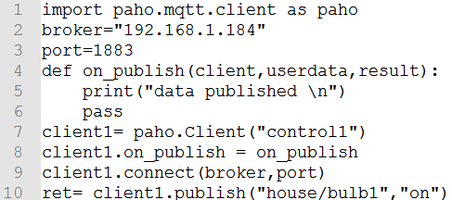
Code
Note 1: you don’t appear to need a client loop to process the on_publish callba

Slide 12
On_publish Callback
When the message has been published to the Broker an acknowledgement is sent that results in the on_publish callback being called.
The on_publish callback function must receive three parameters: on_publish(client, userdata, mid)

Slide 13
On_publish Callback
The client is the client object, and is useful when you have multiple clients that are publishing data.
The userdata is user defined data which isn’t normally used.
The mid value is the message id and can be used with the mid value returned from the publish method to check that a particular message has been published.

Slide 14
Subscribe
To subscribe to a topic you use the subscribe method of the Paho MQTT Class object.
The subscribe method accepts 2 parameters – A topic or topics and a QOS (quality of Service): subscribe(topic, qos=0)
Notes:
http://www.steves-internet-guide.com/subscribing-topics-mqtt-client/

Slide 15
Subscribe Methods
Method 1- Uses a single topic string This is an example function call.
client1.subscribe(“house/bulb1”,1)
Method 2- Uses single tuple for topic and QOS -(topic,qos)
client1.subscribe((“house/bulb2”,2))
Method 3- Used for subscribing to multiple topics and uses a list of tuples [(topic1,qos),(topic2,qos),(topic3,qos)]
client1.subscribe([(“house/bulb3”,2),(“house/bulb4”,1),(“house/bulb5”,0)])

Slide 16
Callback
Callbacks are functions that are called in response to an event
Notes:
http://www.steves-internet-guide.com/mqtt-python-callbacks/

Slide 17
Paho Callback
Event Connection acknowledged Triggers the on_connect callback
Event Disconnection acknowledged Triggers the on_disconnect callback
Event Subscription acknowledged Triggers the on_subscribe callback
Event Un-subscription acknowledged Triggers the on_unsubscribe callback
Event Publish acknowledged Triggers the on_publish callback
Event Message Received Triggers the on_message callback
Event Log information available Triggers the on_log callback

Slide 18
Callback Mechanism
1. Create the callback function
2. Assign the function to the callback.
The Paho client is designed to only use the callback functions if they exist, and doesn’t provide any default callback functions.

Slide 19
Example
1. Create callback function
First I create my function. I’ve called it on_connect but I could have called it anything I wanted.
def on_message(client, userdata, message):
print("message received " ,str(message.payload.decode("utf-8")))
The function simply print the message

Slide 20
Example
2. Now, associate callback function
client.on_connect= on_connect
If my function had been called myfunction then I would use the following:
client.on_connect= myfunction

Slide 21
Callbacks and the Client Loop
Callbacks are dependent on the client loop as without the loop the callbacks aren’t triggered.

Slide 22
Understanding Loop
When new messages arrive at the Python MQTT client they are placed in a receive buffer.
The messages sit in this receive buffer waiting to be read by the client program.
You could program the client to manually read the receive buffers but this would be tedious.
The loop() function is a built in function that will read the receive and send buffers, and process any messages it finds.
Notes:
http://www.steves-internet-guide.com/loop-python-mqtt-client/

Slide 23
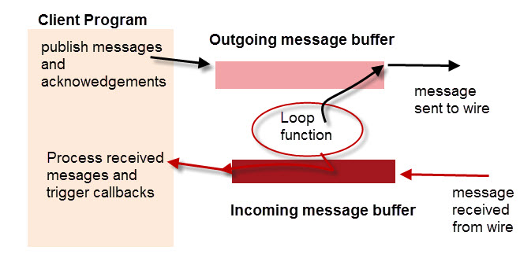
Loop

Slide 24
Three methods Paho Python Loop
loop_start()
The loop_start() starts a new thread, that calls the loop method at regular intervals for you. It also handles re-connects automatically.
To stop the loop use the loop_stop() method.
loop_forever()
The loop_forever() method blocks the program, and is useful when the program must run indefinitely.
The loop_forever() function also handles automatic reconnects.
loop()

Slide 25
Loop()
The loop can be stopped by calling loop.stop().
You should stop the loop before you exit the script.
You can also manually call the loop() method in your program.
If you do this you must remember to call it regularly.

Slide 26
MQTT QoS
The Quality of Service (QoS) level is an agreement between the sender of a message and the receiver of a message that defines the guarantee of delivery for a specific message.
Three QoS level in MQTT

Slide 27
MQTT QoS Level
At most once (0)
At least once (1)
Exactly once (2).

Slide 28
QoS 0 – at most once
The minimal QoS level is zero.
This service level guarantees a best-effort delivery.
There is no guarantee of delivery.
The recipient does not acknowledge receipt of the message and the message is not stored and re-transmitted by the sender.
QoS level 0 is often called “fire and forget” and provides the same guarantee as the underlying TCP protocol.

Slide 29
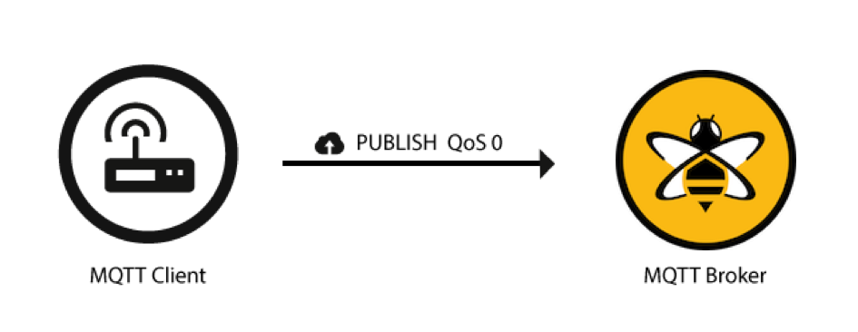
Illustration

Slide 30
QoS 1 - at least once
QoS level 1 guarantees that a message is delivered at least one time to the receiver.
The sender stores the message until it gets a PUBACK packet from the receiver that acknowledges receipt of the message.
It is possible for a message to be sent or delivered multiple times.

Slide 31
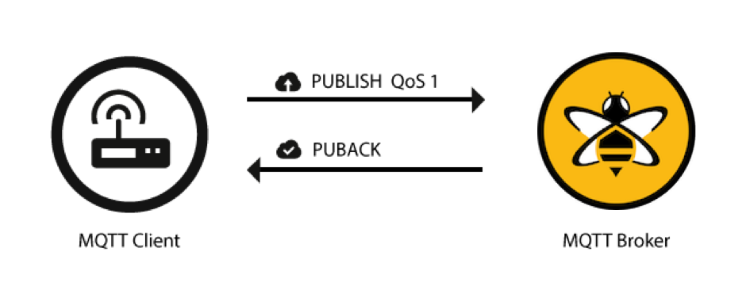
Illustration

Slide 32
QoS 2 - exactly once
QoS 2 is the highest level of service in MQTT.
This level guarantees that each message is received only once by the intended recipients.
QoS 2 is the safest and slowest quality of service level.
The guarantee is provided by at least two request/response flows (a four-part handshake) between the sender and the receiver.
The sender and receiver use the packet identifier of the original PUBLISH message to coordinate delivery of the message.

Slide 33
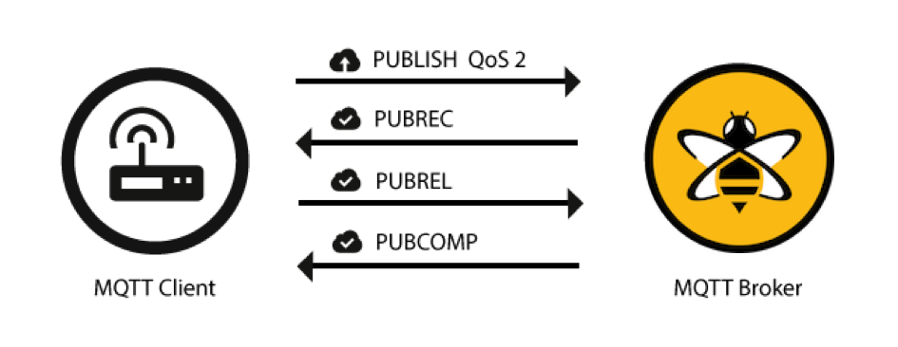
Illustration

Slide 34
Use QoS 0 When …
You have a completely or mostly stable connection between sender and receiver. A classic use case for QoS 0 is connecting a test client or a front end application to an MQTT broker over a wired connection.
You don’t mind if a few messages are lost occasionally. The loss of some messages can be acceptable if the data is not that important or when data is sent at short intervals
You don’t need message queuing. Messages are only queued for disconnected clients if they have QoS 1 or 2 and a persistent session.

Slide 35
Use QoS 1 when …
You need to get every message and your use case can handle duplicates. QoS level 1 is the most frequently used service level because it guarantees the message arrives at least once but allows for multiple deliveries. Of course, your application must tolerate duplicates and be able to process them accordingly.
You can’t bear the overhead of QoS 2. QoS 1 delivers messages much faster than QoS 2.

Slide 36
Use QoS 2 when …
It is critical to your application to receive all messages exactly once. This is often the case if a duplicate delivery can harm application users or subscribing clients. Be aware of the overhead and that the QoS 2 interaction takes more time to complete

Slide 37
THANK YOU

